Slide 1
Inherited Traits and Learned Behaviors
We are learning to explain and give examples of inherited traits and learned behaviors

Slide 2
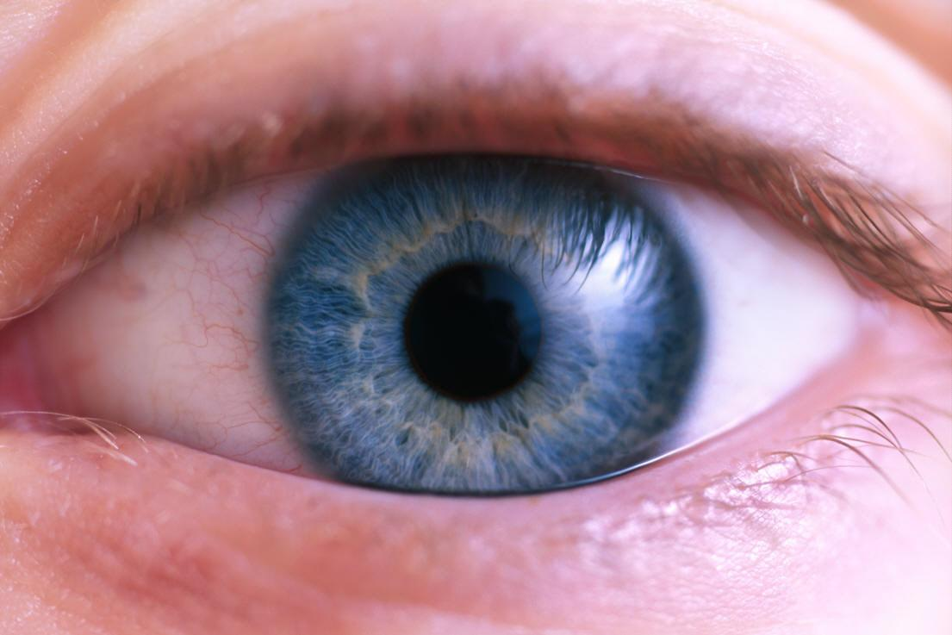
How would you describe yourself?
I might say that I have blue eyes and that I like to run.
Let’s make a list of words / phrases that describe you!!! (jot down 5 on your sheet)
Now let’s look at your list…how many of your words / phrases could also describe someone in your family?

Slide 3
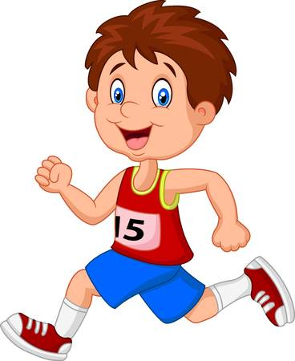
How would you describe yourself?
(cont.)
Maybe no one in my family likes to run, but one of my parents has blue eyes.
Your eye color came from your parents, but you learned to like running.

Slide 4
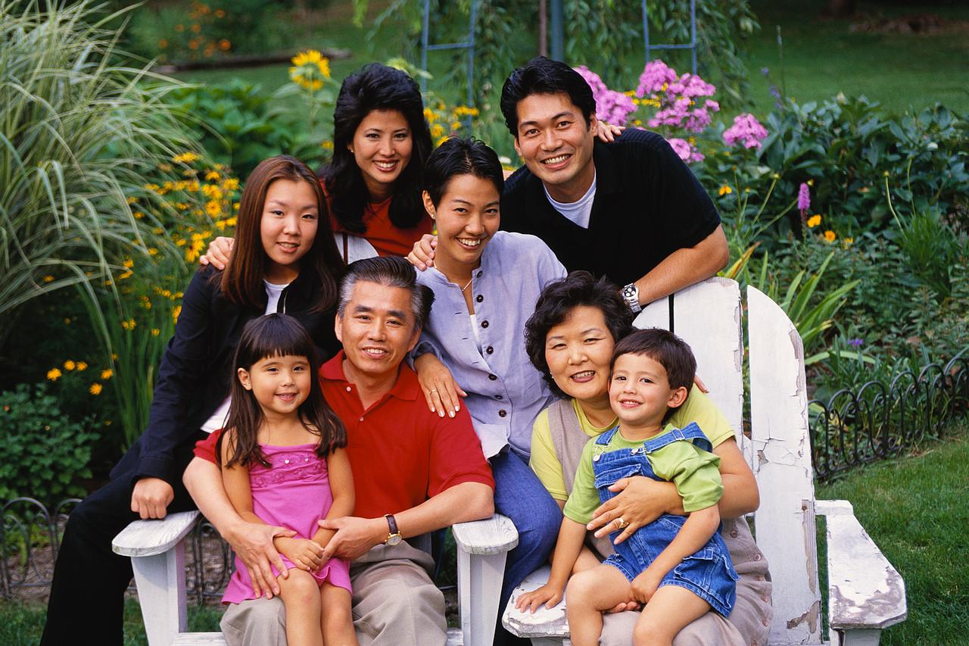
Humans (and other animals) are a mix of characteristics from their parents and behaviors they learn on their own.
An inherited trait is a characteristic that is passed onto offspring.

Slide 5
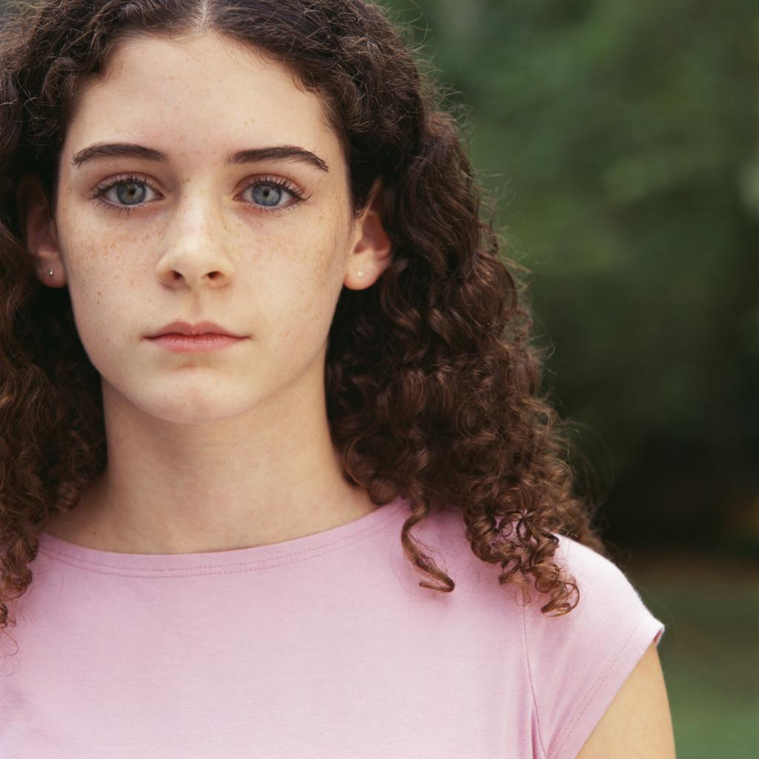
Inherited Traits (cont.)
Eye color
Skin color
Hair color
Curly or straight hair
Dimples
Freckles
Height

Slide 6
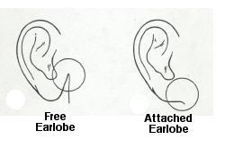
Inherited Traits (cont.)
Are your earlobes attached to the side of your head, or do they hang free?
The shape of your earlobe is an inherited trait
Tongue rolling

Slide 7
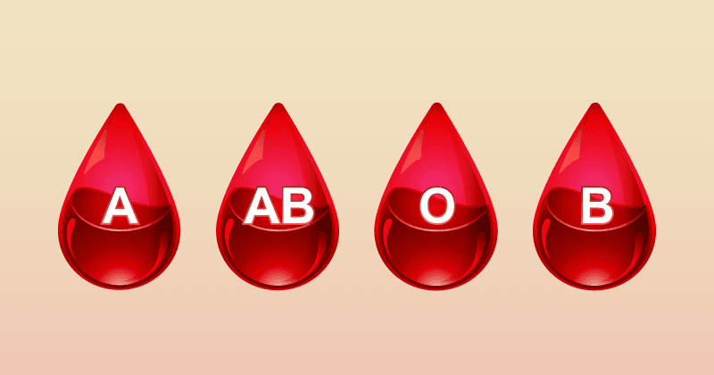
Inherited Traits (cont.)
Some of your traits are inherited, but not seen
Blood type
Handedness
Red / Green color blindness
Some diseases / disorders

Slide 8
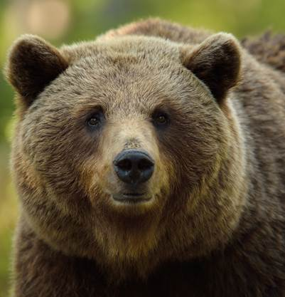
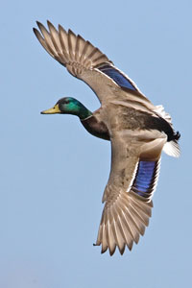
Inherited Behaviors
A behavior is a way of acting. Behaviors can be inherited.
Behaviors that are passed from parent to offspring are called instincts.
Many animals are born with instincts that help them survive.
Can you think of any animal instincts?

Slide 9
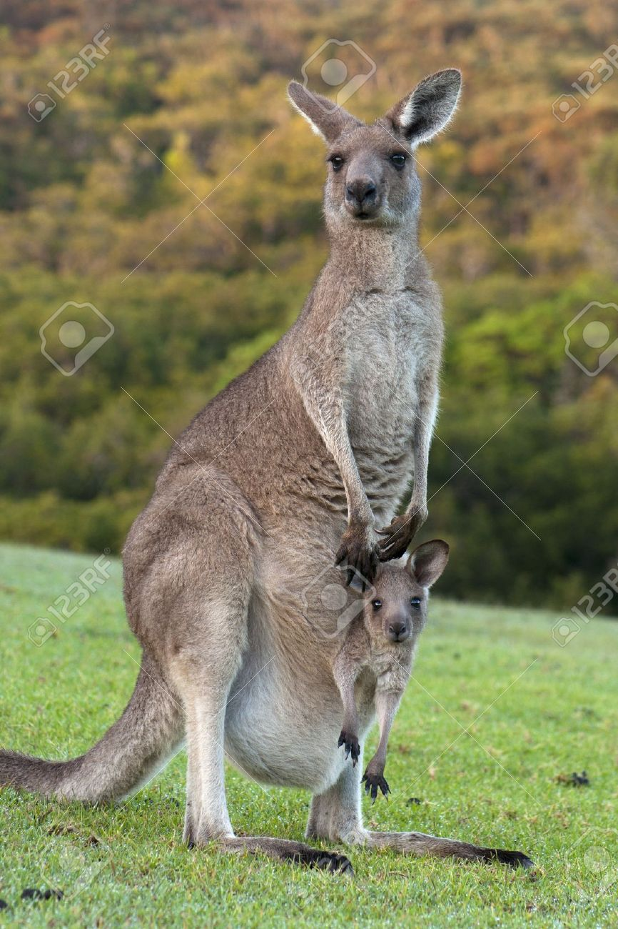
Inherited Behavior Examples
Some animals head for warmer climates (migrate). Other animals find a safe spot and curl up for a long sleep (hibernate).
No one taught these animals how to survive winters. They know what to do by instinct.

Slide 10
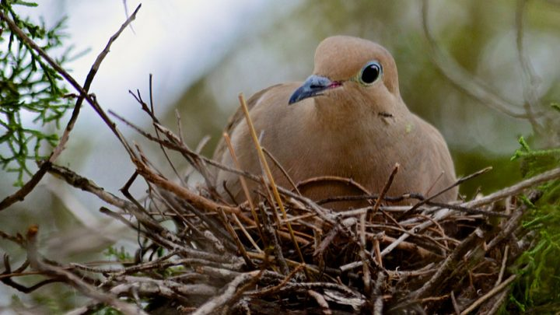
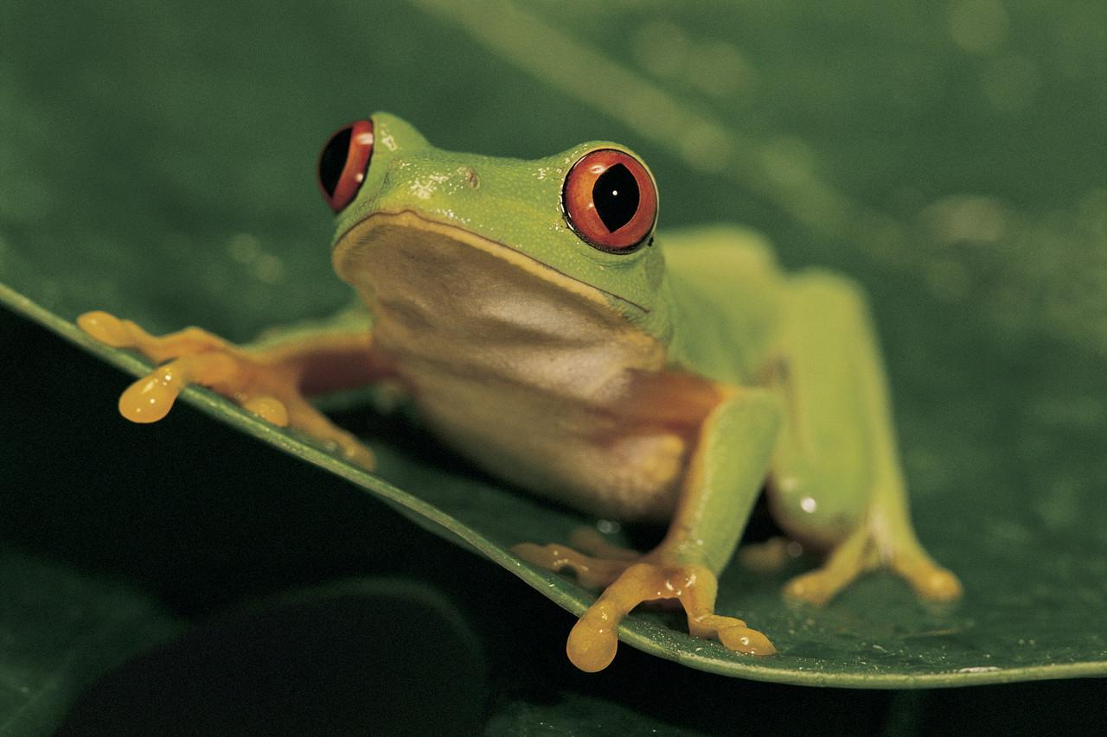
Inherited Behavior Examples (cont.)
Birds protect their eggs and babies by instinct.
Frogs are not born with this instinct. They leave their eggs to hatch or die on their own.

Slide 11
Learned Behaviors
Are you better at using the computer than some of the adults in your family? It is because you learned this, you did not inherit this behavior.
Learned behaviors are caused by the environment.

Slide 12
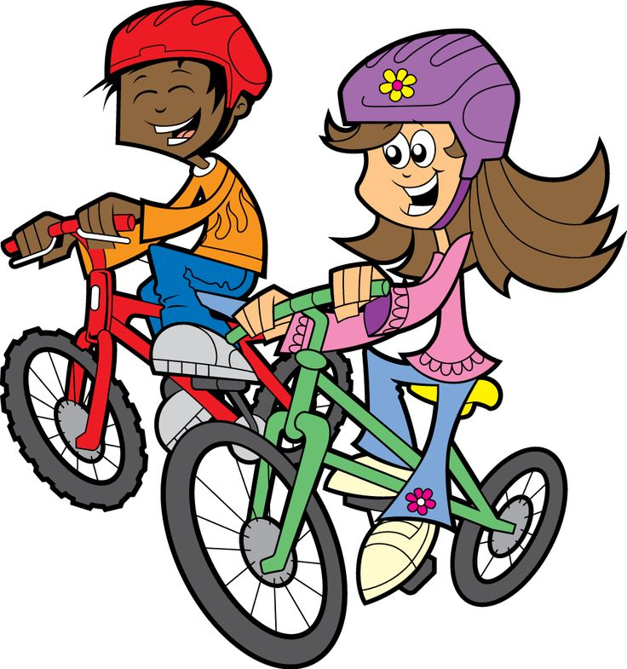
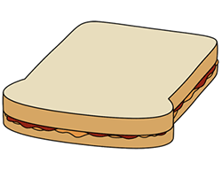
Learned Behaviors (cont.)
We learn many behaviors that we use everyday.
These behaviors include: how to get dressed, brush your teeth, make a sandwich, ride a bike, and be polite to others.

Slide 13
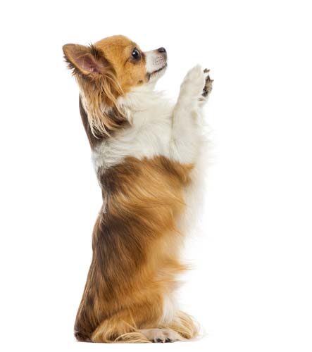
Learned Behaviors (cont.)
Can you learn behaviors that do not help you?
Yes!
They can include watching too much television or eating poorly.
Can animals learn behaviors?
Yes!
Can your dog sit? fetch? beg?

Slide 14
Summary…
An inherited trait is a characteristic that is passed from parents to their babies (offspring).
A behavior is a way of acting.
Inherited behaviors are called instincts.
Learned behaviors are not inherited but learned from others.

Slide 15

Quiz Time

Slide 16
Which of these is an inherited trait?
Liking the color red
Having long fingers
Combing your hair everyday
Being a good musician
b

Slide 17
Which of these is a learned behavior?
Being right handed
Having curly hair
Heading south for the winter
Liking peanut butter and jelly sandwiches
d

Slide 18
Which of these can you change?
Your instincts
Your inherited traits
Your learned behaviors
Your inherited behaviors
c

Slide 19
A woman is an excellent cook. Why are her children likely to become good cooks?
They will learn to cook by instinct
They will learn to cook by watching and practicing
They will inherit her cooking skills
Cooking is an inherited trait
b

